Slide 1


Guatemala SQL Server group
March 2019

Slide 2

Christian Araujo @charaujo
Carlos Lopez @CarlosLopezSQL
Eduardo Pivaral @EduardoDBA
Carlos Robles @dbamastery
* Allan Fong @omegagt
gtssug.pass.org
Board Members

Slide 3

Upcoming Virtual Group Webinars
Virtual Group | Meeting Date | Time | Topic | Website
Cloud | Mar 28, 2019 | 17:00 – 18:00 (UTC) | Shard Attack - Horizontal Scaling in Azure SQL Database - David Postlethwaite | cloud.pass.org
DBA Fundamentals | Apr 2, 2019 | 16:00 – 17:00 (UTC) | Performance Troubleshooting Using Wait Statistics - Paul Randal | fundamentals.pass.org
Professional Development | Apr 3, 2019 | 16:00 – 17:00 (UTC) | Working at Microsoft, Certifications and Diversity - George Walters | professionaldevelopment. pass.org
Cloud | Apr 4, 2019 | 17:00 – 18:00 (UTC) | ETL2.0: Data Engineering with Azure Databricks - Asanka Padmakumara | cloud.pass.org
DBA Fundamentals | Apr 9, 2019 | 02:30 – 03:30 (UTC) | Containers - You Better Get on Board! - Anthony Nocentino | fundamentals.pass.org

Slide 4
Upcoming Virtual Group Webinars
Virtual Group | Meeting Date | Time | Topic | Website
Data Architecture | Apr 10, 2019 | 18:00 – 19:00 (UTC) | Going Asynchronous with Service Broker - Jonathan Kehayias | dataarch.pass.org
Cloud | Apr 11, 2019 | 17:00 – 18:00 (UTC) | Azure Intelligent Services - Amie Mason | cloud.pass.org
DBA Fundamentals | Apr 16, 2019 | 16:00 – 17:00 (UTC) | 3 Performance Tuning Tricks you Always Wanted to Know - Pinal Dave | fundamentals.pass.org
Cloud | Apr 18, 2019 | 17:00 – 18:00 (UTC) | Azure Data Factory v2 with Data Flows Capabilities - Kamil Nowinski | cloud.pass.org
Cloud | Apr 25, 2019 | 17:00 – 18:00 (UTC) | Azure Data Factory V2 - Kevin Wilkie | cloud.pass.org

Slide 5


24HOP: 20 Years of PASS – Past Learnings and Future Visions April 03 – 04, 2019
As we get ready to celebrate 20 years of PASS supporting community thought leaders, we’re looking for new PASS members and first-time speakers to share their insights on the future of data and how they see the industry, and their careers, evolving over the next 20 years.
Registration is opening on March 20, 2019! Stay tuned for more information!
Learn More
pass.org/24hours/2019/20years/About.aspx

Slide 6


Upcoming SQLSaturdays
US/Canada
EMEA
#826 Victoria – Mar 16, 2019
#825 Chicago – Mar 23, 2019
#859 Tampa – Mar 23, 2019
#822 Spokane – Mar 23, 2019
#846 Richmond – Mar 30, 2019
#827 Cincinnati – Mar 30, 2019
#813 Boston – BI Edition – Mar 30, 2019
#842 Madison – Apr 06, 2019
#830 Colorado Springs – Apr 06, 2019
#843 Québec – Apr 12, 2019
#847 Orange County – Apr 13, 2019
#863 Raleigh – April 27, 2019
#840 Edmonton – April 27, 2019
#807 Redmond – April 27, 2019
#816 Iceland – Mar 16, 2019
#832 Croatia – Apr 06, 2019
#823 Israel – Apr 11, 2019
#850 Budapest – Apr 20, 2019
#848 Yaounde – April 27, 2019
LATAM
#819 Brasilia – Mar 30, 2019
#817 Joinville – Apr 06, 2019
#813 Santiago – Apr 13, 2019

Slide 7

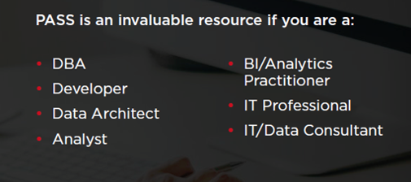
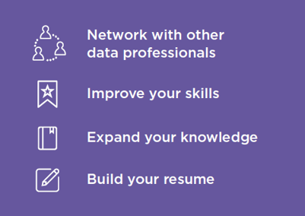

Join PASS to Grow Your Career
Connect with a global network of 250,000+ data professionals
Become a member and gain free access to:
Online educational content
Live webinars
In-person meetups, events, and conferences
Networking, volunteering, and speaking opportunities
The Community
The Benefits
… Join Today!
Notes:
PASS is a global, not-for-profit association where data professionals Connect, Share and Learn.
Joining PASS is free, and gives you access to hundreds of hours of free online content, live virtual and in-person events, the ability to join Local Groups in your area, and an annual conference, PASS Summit.
PASS is a great way to connect with like-minded professionals, increase your technical expertise, and grow your career.

Slide 8


Tech news
preview support for PostgreSQL in Azure Data Studio
Azure Data Studio is complementary to SQL Server Management Studio with experiences around query editing and data development, while SQL Server Management Studio still offers the broadest range of administrative functions, and remains the flagship tool for platform management tasks.
And correspondingly a
preview PostgreSQL extension in Visual Studio Code (VS Code)
is a cross-platform modern editor focused on data development.
It's available for Linux, MacOS, and Windows. Plus, Azure Data Studio
comes with an integrated terminal so you're never far away from psql.
Download link
More information

Slide 9
Tech news
SQL Server 2016 Service Pack 1 Cumulative Update #6 Released! March 19
SQL Server 2017 RTM Cumulative Update #14 Released! March 25, 2019
Important behavior change in Pacemaker package
Query Store notice for users of QS (CU2)
More information

Slide 10

SentryOne Plan Explorer Simplify Your SQL Server Query Tuning
Plan Explorer helps you quickly get to the root of the toughest SQL Server query problems.
Break through database performance barriers with advanced query tuning features not found in any other tool.
Plan Explorer is a single installation file containing the application and the SQL Server Management Studio (SSMS) add-in
Plan Explorer is Free to use.
You can download it from here:
https://www.sentryone.com/plan-explorer

Slide 11

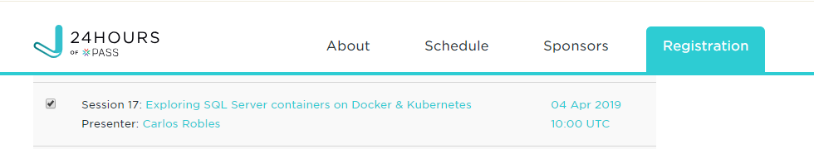

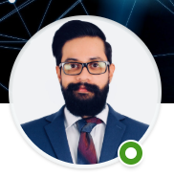
Community news
Carlos Robles representing GT in 24 hours of PASS
Alejandro Cobar and Mynor Bolaños congratulations on your new Job!

Slide 12
Call for speakers
Want to participate as speaker in the next Guatemala's SQL Server User Group meeting? Then fill out the online form with a brief description of your session here:
https://gtssug.pass.org/en-us/sessionsubmission.aspx

Slide 13



Sponsors
Want to become a sponsor? Send an email to: gtssug@pass.org

Slide 14




Follow us
Sign up for a free membership today at:
GTSSUG.PASS.org
#SQLPassGT @gtssug

Slide 15


Connect with PASS
Sign up for a free membership today at:
PASS.org
#sqlpass @sqlpass
@passcommunity

